Slide 1
Mandatory Policies

Slide 2
Towards Mandatory Policies
Processes run programs which, unless properly certified, cannot be trusted for the operations they execute
For this reason, restrictions should be enforced on the operations that processes themselves can execute
In particular, protection against Trojan Horses leaking information to unauthorized users requires controlling the flows of information within processes execution and possibly restricting them
Mandatory policies provide a way to enforce information flow control through the use of labels

Slide 3
Mandatory Flow Control Models
Definition: Mandatory access control refers to a type of access control by which the operating system constrains the ability of a subject or initiator to access or generally perform some sort of operation on an object or target.
Why is it necessary since we have discretionary security model?
With the advances in networks and distributed systems, it is necessary to broaden the scope to include the control of information flow between distributed nodes on a system wide basis rather than only individual basis like discretionary control.

Slide 4
Difference between Discretionary and Mandatory access control
Mandatory access control, this security policy is centrally controlled by a security policy administrator; users do not have the ability to override the policy and, for example, grant access to files that would otherwise be restricted.
By contrast, discretionary access control (DAC), which also governs the ability of subjects to access objects, allows users the ability to make policy decisions and/or assign security attributes.

Slide 5
Major problem with the Access Control Matrix Model
Confinement problem: How to determine whether there is any mechanism by which a subject authorized to access an object may leak information contained in that object to some other subjects not authorized to access that object.
Another disadvantage is that no semantics of information in the objects are considered; thus the security sensitivity of an object is hardly expressed by that model.

Slide 6
Multilevel Security
Hierarchy: Top Secret, Secret, Confidential, …
Information must n’t leak from High down to Low
Enforcement must be independent of user actions!
Perpetual problem: careless staff
1970s worry: operating system insecurity
1990s worry: virus at Low copies itself to High and starts signalling down (e.g. covert channel)

Slide 7
Multilevel Security Policy
Mandatory security policies enforce access control on the basis of regulations mandated by a central authority
The most common form of mandatory policy is the multilevel security policy, based on the classifications of subjects and objects in the system
Objects are passive entities storing information
Subjects are active entities that request access to the objects

Slide 8
There is a distinction between subjects of the mandatory policy and the authorization subjects considered in the discretionary policies
While authorization subjects typically correspond to users (or groups thereof), mandatory policies make a distinction between users and subjects
Users are human beings who can access the system, while subjects are processes (i.e., programs in execution) operating on behalf of users
This distinction allows the policy to control the indirect accesses (leakages or modifications) caused by the execution of processes

Slide 9
Multi-Level Security (MLS)
Sensitive information be disclosed only to authorized personnel
Paper World: assign each document and each employee a security level indicating sensitivity and authority.
Levels: Unclassified, confidential, secret, top_secret
Levels form a partially ordered set: an employee is authorized to read a document only if his level is greater than or equal to that of the document

Slide 10
MLS for Information Systems
Not all information is in the form of documents
Not all consumers are employees
Two Aspects:
Access Control: Determining who can see information of a given sensitivity leaving the system.
Correct Labeling: Determining the sensitivity of information entering and leaving the system.
Important in the context of Trojan Horses
Challenge: Build systems that are secure even in the presence of malicious programs

Slide 11
Security Classifications
In multilevel mandatory policies, an access class is assigned to each object and subject
The access class is one element of a partially ordered set of classes
The partial order is defined by a dominance relationship, which we denote with ≥
In the most general case, the set of access classes can simply be any set of labels that together with the dominance relationship defined on them form a POSET (partially ordered set)

Slide 12
Information Flows
Secret
Confidential
Unclassified

Slide 13
Most commonly an access class is defined as consisting of two components: a security level and a set of categories
The security level is an element of a hierarchically ordered set
The set of categories is a subset of an unordered set, whose elements reflect functional, or competence areas
The dominance relationship ≥ is then defined as follows: an access class c₁ dominates (≥) an access class c₂ iff the security level of c₁ is greater than or equal to that of c₂ and the categories of c₁ include those of c₂

Slide 14
Formally, given a totally ordered set of security levels L, and a set of categories C, the set of access classes is AC=L×2^{C}, and ∀c₁ = (L₁,C₁), c₂ = (L₂,C₂): c₁ ≥ c₂ ⇐⇒ L₁ ≥ L₂ ∧ C₁ ⊇ C₂
Two classes c₁ and c₂ such that neither c₁ ≥ c₂ nor c₂ ≥ c₁ holds are said to be incomparable
It is easy to see that the dominance relationship so defined on a set of access classes AC satisfies the following properties
reflexivity, transitivity, antisymmetry
Existence of a least upper bound (LUB) and a greatest lower bound (GLB)

Slide 15
Access classes defined as above together with the dominance relationship between them therefore form a lattice
The semantics and use of the classifications assigned to objects and subjects within the application of a multilevel mandatory policy is different depending on whether the classification is intended for a secrecy or an integrity policy

Slide 16
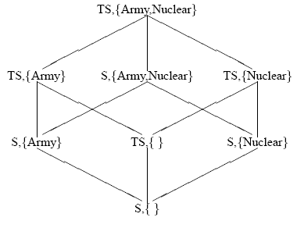
An example security lattice

Slide 17
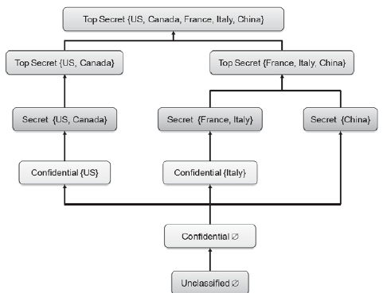
Defining Security Levels using Categories

Slide 18
Secrecy-based mandatory policies
A secrecy mandatory policy controls the direct and indirect flows of information to the purpose of preventing leakages to unauthorized subjects
The security level of the access class associated with an object reflects the sensitivity of the information contained in the object, that is, the potential damage that could result from the unauthorized disclosure of the information
The security level of the access class associated with a user, also called clearance, reflects the user’s trustworthiness not to disclose sensitive information to users not cleared to see it

Slide 19
Categories define the area of competence of users and data and are used to provide finer grained security classifications of subjects and objects than classifications provided by security levels alone. They are the basis for enforcing need-to-know restrictions
Users can connect to the system at any access class dominated by their clearance
A user connecting to the system at a given access class originates a subject at that access class

Slide 20
The Lattice Model
The best-known Information Flow Model
Based upon the concept of lattice whose mathematical meaning is a structure consisting of a finite partially ordered set together with a least upper bound and greatest lower bound operator on the set.
Lattice is a Directed Acyclic Graph(DAG) with a single source and sink.
Information is permitted to flow from a lower class to upper class.

Slide 21
The lattice model (continued)

Slide 22
The lattice model (continued)
This satisfies the definition of lattice. There is a single source and sink.
The least upper bound of the security classes {x} and {z} is {x,z} and the greatest lower bound of the security classes {x,y} and {y,z} is {y}.

Slide 23
Flow Properties of a Lattice
The relation → is reflexive, transitive and antisymmetric for all A,B,C Ɛ SC.
Reflexive: A → A
Information flow from an object to another object at the same class does not violate security.
Transitive: A → B and B → C implies A → C .
This indicates that a valid flow does not necessarily occur between two classes adjacent to each other in the partial ordering
Antisymmetric: A → B and B → A implies A=B
If information can flow back and forth between two objects, they must have the same classes

Slide 24
Flow Properties of a Lattice (Contd..)
Two other inherent properties are as follows
Aggregation: A → C and B → C implies A U B → C
If information can flow from both A and B to C , the information aggregate of A and B can flow to C.
Separation: A U B → C implies A → C and B → C
If the information aggregate of A and B can flow to C ,information can flow from either A or B to C

Slide 25
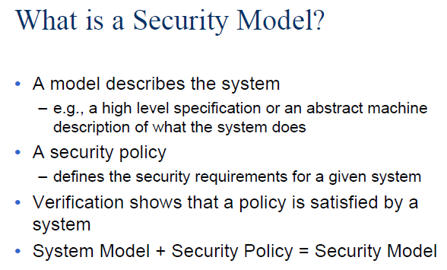

Slide 26
Multilevel Security Models
Multilevel Security is a special case of the lattice-based information flow model. There are two well-known multilevel security models:
The Bell-LaPadula Model Focuses on confidentiality of information
The Biba Model Focuses on system integrity

Slide 27
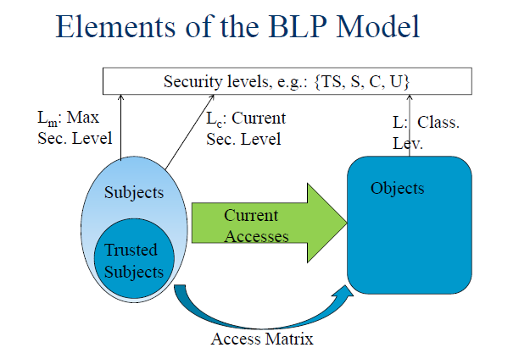

Slide 28
The Bell-LaPadula Model
L is a linearly ordered set of security levels
C is a lattice of security categories
The security class assigned to a subject or an object includes two components: a hierarchical security level and a nonhierarchical security category.
The security level is called the clearance if applied to subjects, and classification if applied to objects.
Each security category is a set of compartments that represent natural or artificial characteristics of subjects and objects and is used to enforce the need-to-know principle.

Slide 29
The Bell-LaPadula Model contd…
Need-to-know principle: A subject is given access only to the objects that it requires to perform its jobs.
The lattice of security classes is L × C. If AB Ɛ SC, A dominates B if A’s level is higher than B’s level and B’s category is a subset of A’s category.

Slide 30
The Bell-LaPadula Model contd…
Security with respect to confidentiality in the Bell-LaPadula model is described by the following two axioms:
Simple security property: Reading information from an object o by a subject s requires that SC(s) dominates SC(o) ”no read up”).
The *-property: Writing information to an object o by a subject s requires that SC(o) dominates SC(s).
Note: In * property , information cannot be compromised by exercising a Trojan Horse program(A code segment that misuses its environment is called a Trojan Horse).
Example of Trojan Horse: Email attachments

Slide 31
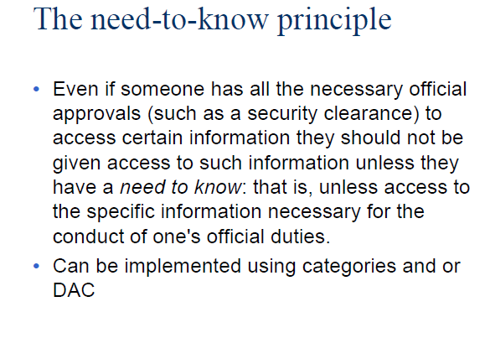

Slide 32
Summarizing BLP

Slide 33
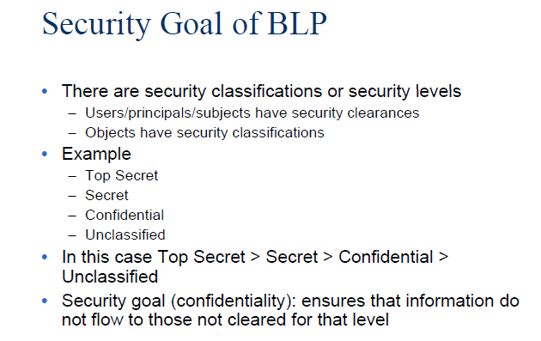

Slide 34
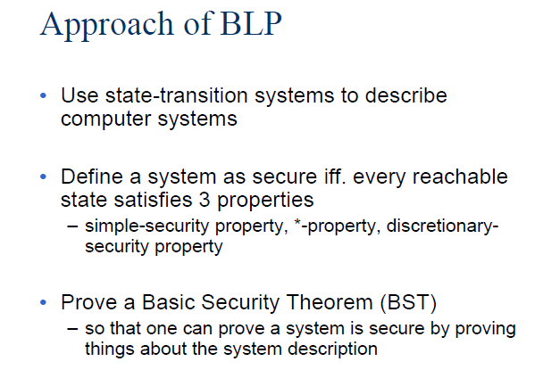

Slide 35
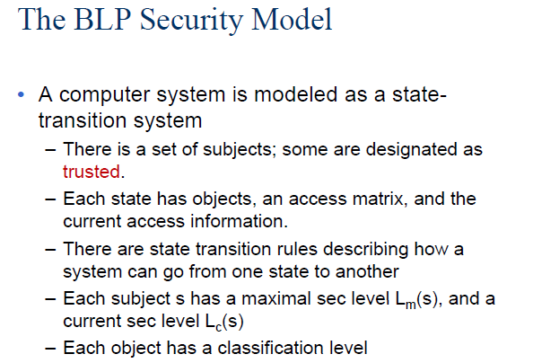

Slide 36
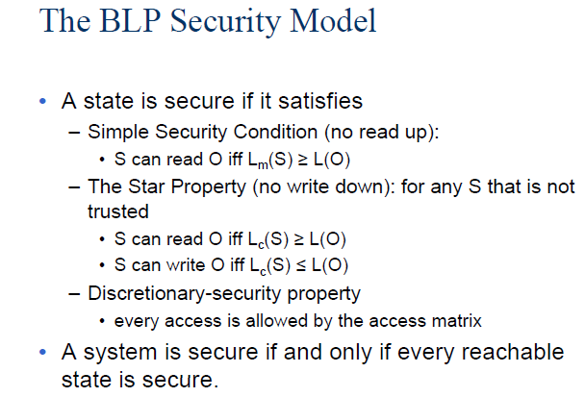

Slide 37
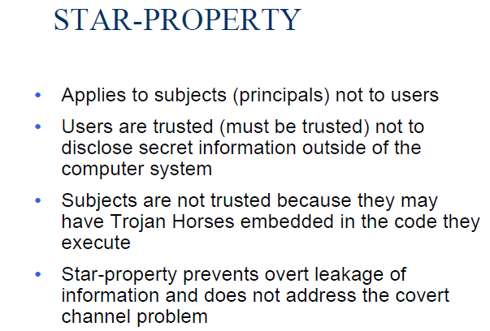

Slide 38
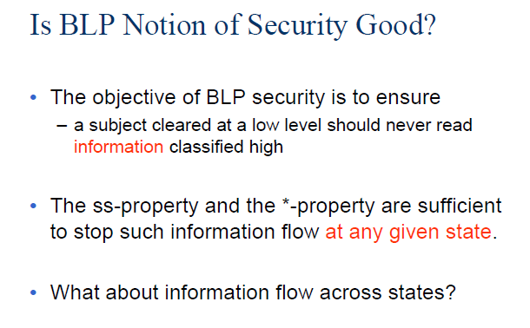

Slide 39
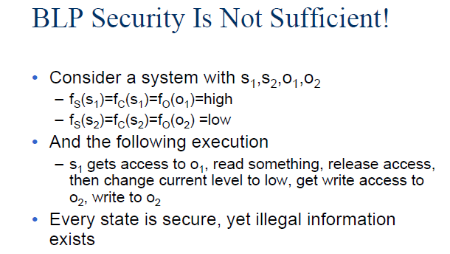
Solution: Tranquility Principle
subject cannot change current levels

Slide 40
Objections to BLP (1)
Some processes, such as memory management, need to read and write at all levels
Fix: put them in the trusted computing base
Consequence: once you put in all the stuff a real system needs (backup, recovery, comms, …) the TCB is no longer small enough to be easily verifiable
Ross Anderson

Slide 41
Objections to BLP(2)
John MacLean’s “System Z”: as BLP but lets users req. temporary declassification of any file
Fix: add tranquility principles
Strong tranquility: labels never change
Weak tranquility: they don’t change in such a way as to break the security policy
Usual choice: weak tranquility using the “high watermark principle” – a process acquires the highest label of any resource it’s touched
Problem: have to rewrite apps (e.g. license server)
Ross Anderson

Slide 42
Objections to BLP (3)
High can’t acknowledge receipt from Low
This blind write-up is often inconvenient: information vanishes into a black hole
Option 1: accept this and engineer for it (Morris theory) – CIA usenet feed
Option 2: allow acks, but be aware that they might be used by High to signal to Low
Use some combination of software trust and covert channel elimination
Ross Anderson

Slide 43
Variants of BLP
Noninterference: no input by High can affect what Low can see. So whatever trace there is for High input X, there’s a trace with High input Ø that looks the same to Low (Goguen & Messeguer 1982)
Nondeducibility: weakens this so that Low is allowed to see High data, just not to understand it – e.g. a LAN where Low can see encrypted High packets going past (Sutherland 1986)
Ross Anderson

Slide 44
Variants on Bell-LaPadula (2)
Biba integrity model: deals with integrity rather than confidentiality. It’s “BLP upside down” – high integrity data mustn’t be contaminated with lower integrity stuff
Domain and Type Enforcement (DTE): subjects are in domains, objects have types
Role-Based Access Control (RBAC): current fashionable policy framework
Ross Anderson

Slide 45
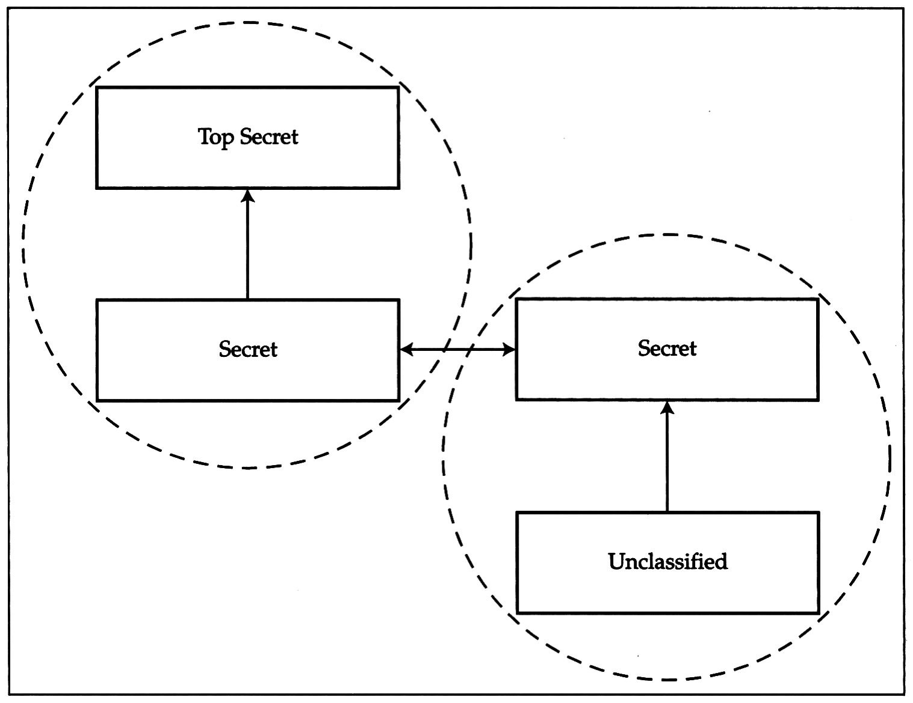
The Cascade Problem
Connecting the two -- issue
Ross Anderson

Slide 46
Consider a simple device that accepts two High inputs H1 and H2, multiplexes them, encrypts them by xor’ing them with a one-time pad, outputs the other copy of the pad on H3, and outputs the ciphertext, which being encrypted with a cipher system giving perfect secrecy, is considered to be Low (output L)

Slide 47
In isolation, this device is provably secure. But if feedback is permitted, then the output from H3 can be fed back into H2, with the result that the high input H1 now appears at the low output L.

Slide 48
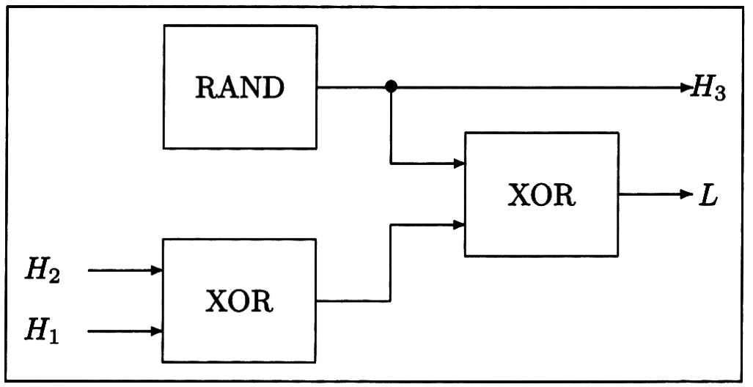
Composability
Systems can become insecure when interconnected, or when feedback is added
Ross Anderson

Slide 49
Composability
So nondeducibility doesn’t compose
Neither does noninterference
Many things can go wrong – clash of timing mechanisms, interaction of ciphers, interaction of protocols
Practical problem: lack of good security interface definitions (Keep in mind API failures)
Labels can depend on data volume, or even be non-monotone (e.g. Secret laser gyro in a Restricted inertial navigation set)
Ross Anderson

Slide 50
Consistency
US approach (polyinstantiation):
UK approach (don’t tell low users):
 | Cargo | Destination
Secret | Missiles | Iran
Unclassified | Spares | Cyprus
 | Cargo | Destination
Secret | Missiles | Iran
Restricted | Classified | Classified
Ross Anderson

Slide 51
Downgrading
A related problem to the covert channel is how to downgrade information
Analysts routinely produce Secret briefings based on Top Secret intelligence, by manual paraphrasing
Also, some objects are downgraded as a matter of deliberate policy – an act by a trusted subject
For example, a Top Secret satellite image is to be declassified and released to the press
Ross Anderson

Slide 52
Examples of MLS Systems
SCOMP – Honeywell variant of Multics, launched 1983. Four protection rings, minimal kernel, formally verified hardware and software. Became the XTS-300
Used in military mail guards
Motivated the ‘Orange Book’ – the Trusted Computer System Evaluation Criteria
First system rated A1 under Orange Book
Ross Anderson

Slide 53
Examples of MLS Systems (2)
Blacker – series of encryption devices designed to prevent leakage from “red” to “black”. Very hard to accommodate administrative traffic in MLS!
Compartmented Mode Workstations (CMWs) – used by analysts who read Top Secret intelligence material and produce briefings at Secret or below for troops, politicians … Mechanisms allow cut-and-paste from L → H, L → L and H → H but not H → L
Ross Anderson

Slide 54
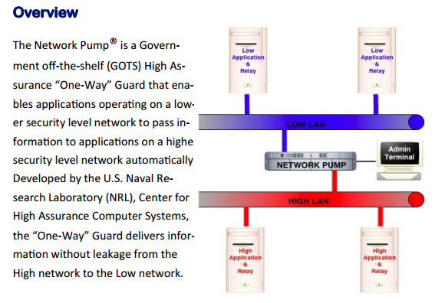
Examples of MLS Systems (3)

Slide 55
Examples of MLS Systems (4)
LITS – RAF Logistics IT System – a project to control stores at 80 bases in 12 countries. Most stores ‘Restricted’, rest ‘Secret’, so two databases connected by a pump
Other application-level rules, e.g. ‘don’t put explosives and detonators in the same truck’
Eventual solution: almost all stuff at one level, handle nukes differently
Ross Anderson

Slide 56
Examples of MLS Systems (5)
DERA’s ‘Purple Penelope’ was an attempt to relax MLS to accountability for lower levels of stuff
Driver: people determined to use Office
Solution: wrapper around Windows that tracks current level using high watermark
Downgrading allowed, but system forces authentication and audit
Now called ‘Sybard Suite’
Ross Anderson

